Slide 1
MOTHER DAIRY
DIGITAL MARKETING

Slide 2
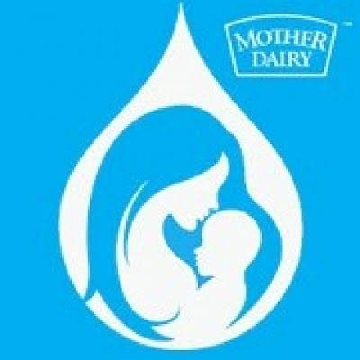
-HAPPY FOOD HAPPY PEOPLE

Slide 3
CONTENTS
INTRODUCTION MOTHER DAIRY
VISION , MISSION &VALUES OF MOTHER DAIRY
UNIQUE SELLING POINT [USP],KPI OF MOTHER DAIRY
BRAND TONE OF MOTHER DAIRY
SMART GOALS OF MOTHER DAIRY
COMPETITORS OF MOTHER DAIRY
SWOT ANAYSIS OF MOTHER DAIRY
SEO&KEYWORD RESEARCH
CONTENT IDEAS & MARKETING STRATEGIES
OVERVIEW OF MOTHER DAIRY
INSTGRAM STORIES

Slide 4
PRESENTED BY
Team Leader : R.ERANNA
Team member : S.MASS

Slide 5
RESEARCH BRAND
MOTHER DAIRY
INTRODUCTION OF MOTHER DAIRY
MOTHER DAIRY is an Indian dairy cooperative brand that represents a network of dairy farmers.
It is known for producing a wide range of dairy products, including milk, butter, cheese, ice cream, and more.
MOTHER DAIRY is famous for its quality, affordability, and its innovative and memorable advertising campaigns.
Mother Dairy is a wholly owned subsidiary of the National Dairy Development Board which is a statutory body under the ownership of the Ministry of Fisheries, Animal Husbandry and Dairying of the Government of India that manufactures, markets and sells milk and dairy products.
Mother Dairy was founded in 1974, as a subsidiary of the National Dairy Development Board (NDDB).
MOTHER DAIRY

Slide 6
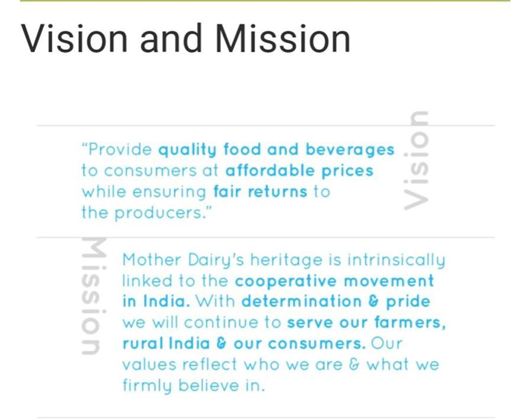
VISION &MISSION OF MOTHER DAIRY
vision
MOTHER DAIRY's vision is to provide more and more satisfaction to the farmers, employees and distributers”
MISSION
GCMMF endeavour to satisfy the taste and nutritional requirements of the customer of the world through excellence in the marketing by the committed team.
VALUES
Customer Orientation
Give Customers a good,fair deal,Great customer relationship take time. Do not try to maximizenshort term profits at the expense of the building those enduring relationships

Slide 7
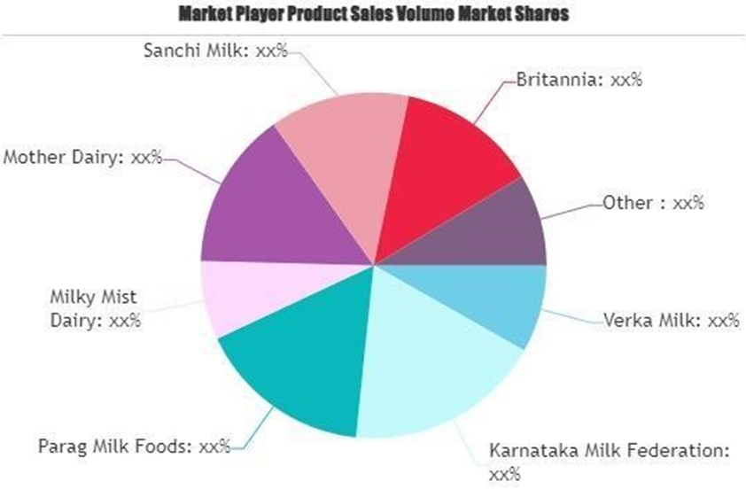
A unique selling point (USP), also called a unique selling proposition, is the essence of what makes your product or service better than competitors
UNIQUE SELLING POINT[USP]
MOTHER DAIRY also offers the broadest range of dairy products, including ghee, butter, milk, chocolate, cheese, sweets, milk powder, ice cream, yogurt, buttermilk, and bread spreads.
The quality, and the taste of MOTHER DAIRY's eatables, are unparalleled.
The variety of MOTHER DAIRY's products caters to a more significant audience segment.
SHORT GOALS OF MOTHER DAIRY
Get more milk from farmers.
Make sure products are good quality.
Sell more in new places.
Create new dairy products.
Deliver products efficiently.

Slide 8

KEY PERFORMANCE INDICATOR OF MOTHER DAIRY
KPI stands for key performance indicator, a quantifiable measure of performance over time for a specific objective.
Revenue and profit.
Amount of milk procured.
Market share.
Product quality.
Distribution and availability.
Customer satisfaction.
SMART GOALS :
Provide safe products to customers.
Develop and empower our people for maintaining a vibrant work environment, which encourages excellence.
Comply with applicable regulations and legislations.
We pledge to provide quality and safe products under clean and hygienic environment.

Slide 9
COMPITETORS OF MOTHER DAIRY
Three competitors of MOTHER DAIRY in the dairy and dairy product industry are:
1. Nestlé: Nestlé is a global food and beverage company that produces a wide range of dairy products, including milk, yogurt, and dairy-based beverages.
2. AMUL : AMUL is a prominent dairy company in India, offering a variety of dairy products, including milk, ice cream, and dairy-based foods.
3. Parag Milk Foods: Parag Milk Foods is another Indian dairy company known for its dairy products, including milk, cheese, and ghee.
These companies compete with MOTHER DAIRY in the market by offering similar dairy products to consumers.

Slide 10
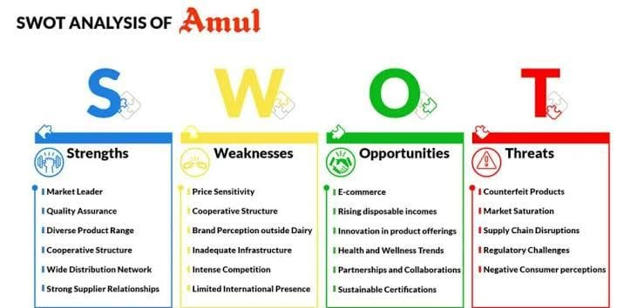
SWOT ANALYSIS
SWOT Analysis Of MOTHER DAIRY
SWOT Analysis of MOTHER DAIRY discusses the company’s strengths, weaknesses.
figuring out how the company is planning to expand its businesses, growth strategies which we call opportunities and threats.
As one of the largest dairy companies in India, it has several strengths, weaknesses, opportunities, and threats.
MOTHER DAIRY

Slide 11
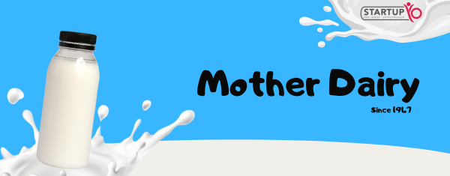
PART -2 SEO &KEYWORD RESEAECH

Slide 12
KEY RESEARCH
Research objectives for MOTHER DAIRY:
*Find New Places to Sell*: Research where they can sell their products in new locations.
*Learn What People Like*: Understand what people prefer when it comes to dairy products.
*Make Safe and Quality Products*: Focus on maintaining safe and high-quality products.
*Efficient Production and Delivery*: Find ways to make milk processing and delivery more efficient.
*Beat the Competition*: Study competitors to be better and different.
*Create New Dairy Products*: Develop new dairy items that match trends like health and sustainability.
*Be Eco-Friendly*: Look into ways to be more environmentally friendly.
*Improve Brand Image*: Understand how people see their brand and work to make it better.
*Explore International Markets*: If they want to sell in other countries, research those markets.
*Cut Costs*: Find ways to save money while still making great products.

Slide 13
SEO
The typical Mother Dairy Fruit & Vegetable Pvt. Ltd. Sales Executive salary is ₹5,09,549 per year.
Sales Executive salaries at Mother Dairy Fruit & Vegetable Pvt. Ltd. Can range from ₹2,40,000 - ₹7,68,194 per year. This estimate is based upon 29 Mother Dairy Fruit & Vegetable Pvt. Ltd.
Sales Executive salary report(s) provided by employees or estimated based upon statistical methods. When factoring in bonuses and additional compensation,
Sales Executive at Mother Dairy Fruit & Vegetable Pvt. Ltd. Can expect to make an average total pay of ₹5,68,061 per year.

Slide 14
COMPETITOR KEYWORDS
Competitor keywords for MOTHER DAIRY could include the names of other dairy and food companies that compete in similar markets, such as:
Nestlé
AMUL
Parag Milk Foods
Britannia
Danone
Gujarat Cooperative Milk Marketing Federation (GCMMF)
Heritage Foods
VITA
OTHERS

Slide 15
LONG-TAIL KEYWORD
Long-tail keywords are specific keyword phrases that typically have lower search volume but can be valuable for targeting a niche audience. For MOTHER DAIRY, a dairy and food company, long-tail keyword explorations could include:
1. "MOTHER DAIRY milk price in [specific city]“
2. "Buy MOTHER DAIRY butter online“
3. "MOTHER DAIRY ghee benefits for health“
4. "MOTHER DAIRY ice cream flavors 2023“
5. "MOTHER DAIRY vs Nestlé dairy products comparison“
6. "MOTHER DAIRY organic milk benefits“
7. "MOTHER DAIRY dairy farm sustainability practices“
8. "Where to find MOTHER DAIRY products near me“
9. "MOTHER DAIRY cheese recipes for kids“
10. "MOTHER DAIRY milk delivery subscription“
These long-tail keywords can help MOTHER DAIRY reach a more targeted audience and provide information or products tailored to their specific needs or interests.

Slide 16
CONTENT IDEAS AND MARKETING STRATEGIES
PART -3

Slide 17
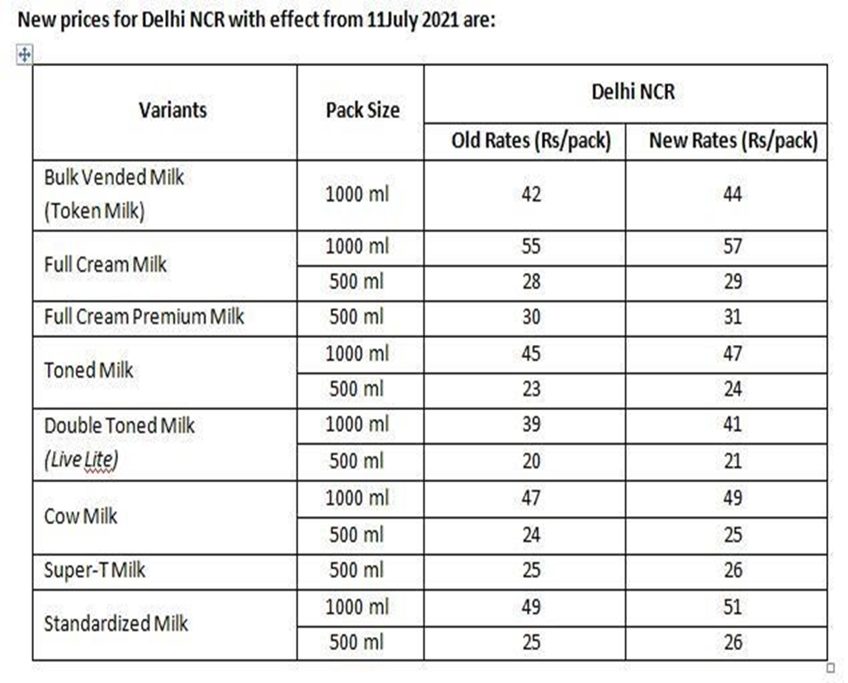

Slide 18
CONTENT IDEAS
Recipe Videos: Create engaging recipe videos featuring Mother dairy products, showcasing various dishes like desserts, curries, or snacks
MOTHER DAIRY Stories: Share the inspiring stories of MOTHER DAIRY's journey, its cooperative model, and how it has impacted farmers and consumers.
3. Dairy Tips: Offer tips on using dairy products in everyday cooking and baking, such as making the perfect paneer or ghee at home.
4. Customer Testimonials: Share positive feedback and experiences from satisfied MOTHER DAIRY customers.
5. Health Benefits: Highlight the nutritional benefits of MOTHER DAIRY products and how they contribute to a balanced diet.
6. Behind-the-Scenes: Show the production process, from farm to table, to give customers insight into how MOTHER DAIRY ensures quality
7. Seasonal Specials: Promote seasonal products and recipes that can be created using MOTHER DAIRY dairy items.

Slide 19
MARKETING STRAEGIES OF MOTHER DAIRY
MOTHER DAIRY's Marketing And Branding Strategies & Marketing Mix.
MOTHER DAIRY has a low-cost pricing strategy for products that are consumed regularly.
This pricing strategy of MOTHER DAIRY made it affordable for its target audience.
Increasing the price of goods proportional to their audience's increase in income helped them retain their customer base.
The typical Mother Dairy Fruit & Vegetable Pvt. Ltd. Sales Executive salary is ₹5,09,549 per year. Sales Executive salaries at Mother Dairy Fruit & Vegetable Pvt. Ltd. Can range from ₹2,40,000 - ₹7,68,194 per year. This estimate is based upon 29 Mother Dairy Fruit & Vegetable Pvt. Ltd.
Sales Executive salary report(s) provided by employees or estimated based upon statistical methods. When factoring in bonuses and additional compensation.
A Sales Executive at Mother Dairy Fruit & Vegetable Pvt. Ltd. Can expect to make an average total pay of ₹5,68,061 per year.

Slide 20
DIGITAL STRATEGY
MOTHER DAIRY's digital marketing strategies have effectively utilized various online platforms to engage with their audience.
Through social media channels like Facebook, Instagram, and Twitter, MOTHER DAIRY has created a strong online presence and interacted with consumers in a personalized and engaging manner.

Slide 21
SOCIAL MEDIA ENGAGEMENT
MOTHER DAIRY has a massive fan base of over 335K followers given that Twitter is a very different platform when compared to other social media platforms.
On various occasions, MOTHER DAIRY posts fun graphics featuring the MOTHER DAIRY Butter Girl.
MOTHER DAIRY produces simple, strategic, and creative campaigns that align with its brand image and resonate with its audience.
They have dipped into social media and digital platforms to generate awareness and connect with their audience.

Slide 22
Overview Of MOTHER DAIRY
MOTHER DAIRY was incorporated to protect the interests of consumers and milk producers in india.
Note: GCMMFL Stands for Gujarat Co-operative Milk Marketing Federation Ltd
MOTHER DAIRY Stands For MOTHER DAIRY Milk Union Limited is also known for starting the white revolution, encouraging local milk farmers to dream.
This is what made them the largest producer of milk products.
It Operates through 61 Offices, 10,000+ Dealers, and 10+ Lakh Retailers which is one of the largest networks in India after railways which has over 20+ employees.
its products range from milk, cheese, butter, milk powders, beverages, ghee, ice cream, and other milk products.
MOTHER DAIRY has been awarded over 10+ awards for excellence in marketing and quality.

Slide 23
INSTAGARAM REEL
PART -4
https://instagram.com/stories/s_t_o_n_e____d_r_i_n_k_e_r/3214551017185969479?utm_source=ig_story_item_share&igshid=MTc4MmM1YmI2Ng==
https://instagram.com/stories/s_t_o_n_e____d_r_i_n_k_e_r/3214560003389996209?utm_source=ig_story_item_share&igshid=NDA3YzJlZDM2MQ==

Slide 24




Slide 25
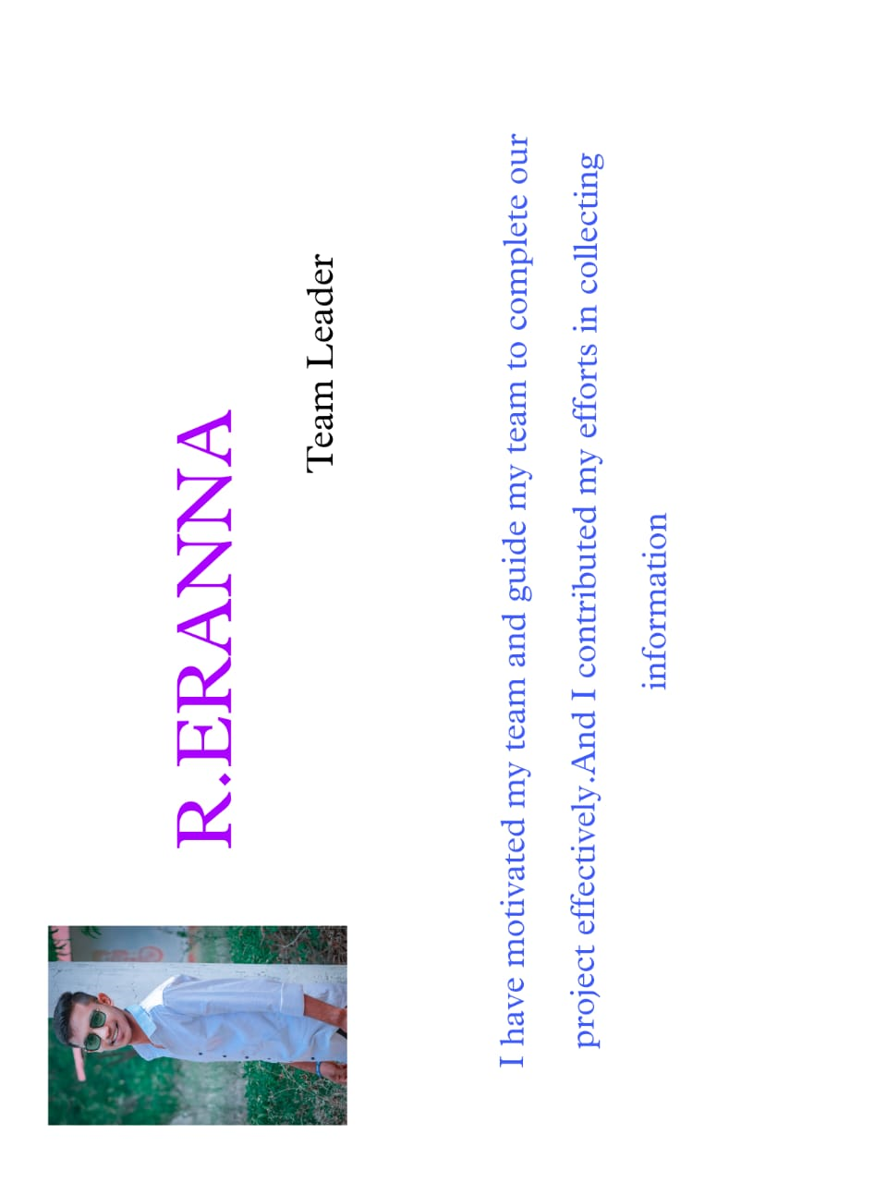
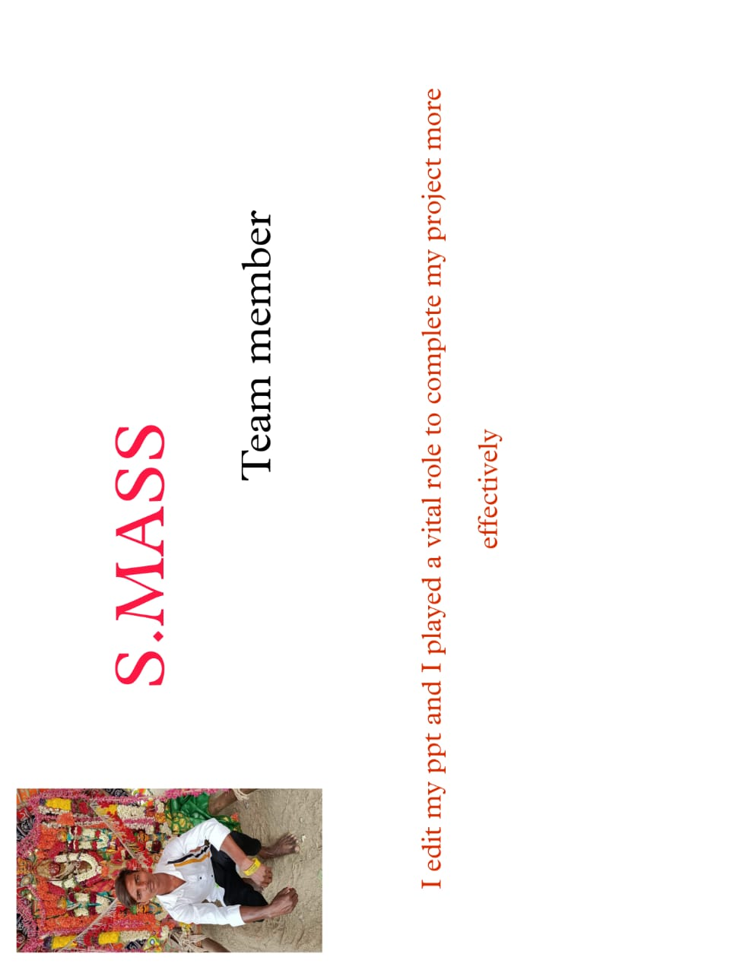
CONTRIBUTION

Slide 26
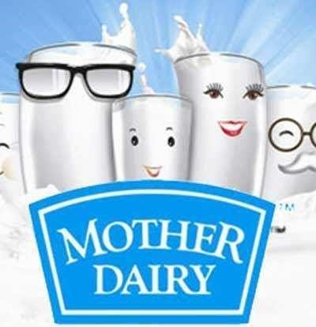
THANK YOU
BE MORE MILK

